Slide 1


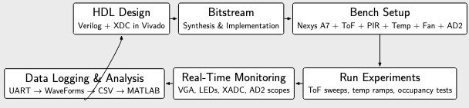
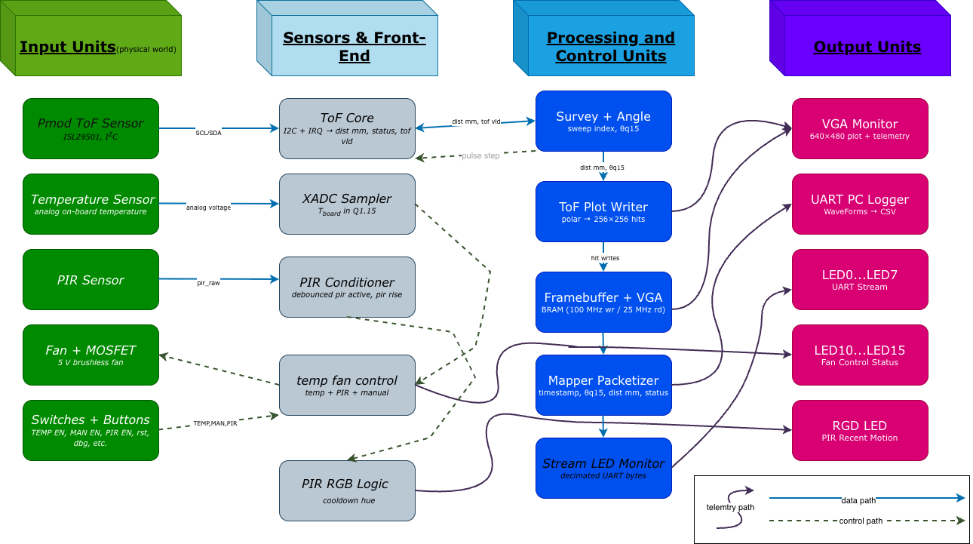
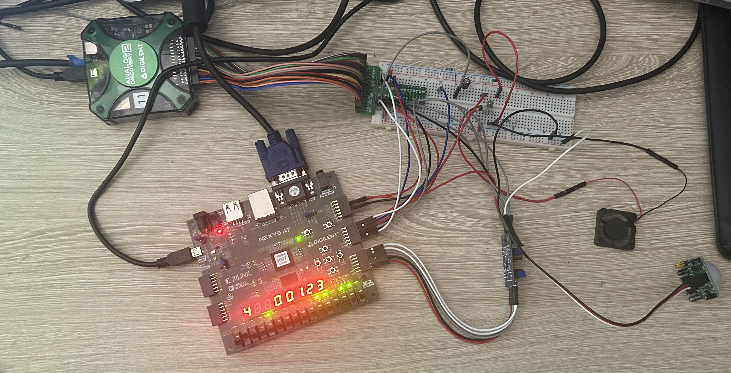
Promoting Innovation in
Project-Based Education–PIPE
PIPEline to Curiosity, Connections, and Creating value
FPGA Signal Control System
Student: David Richardson
Course: ECE-375 Introduction to Computer Architecture
Faculty : Professor Furat-Al-Obaidy
System Overview
FPGA platform: Digilent Nexys A7-100T (Artix-7, 100 MHz system clock).
Major subsystems:
ToF range acquisition
  I²C master talking to an ISL29501 Pmod ToF sensor.
  Q1.15 polar angle encoder and millimeter distance samples.
  Ready/valid streaming into the packetizer and UART.
Temperature sensing & fan control
  XADC channel monitors board temperature (converted to Q1.15).
  Occupancy via PIR sensor; manual override via slide switches.
  PWM duty-based fan drive using external MOSFET and 5 V fan.
Visualization & logging
  640×480@60 Hz VGA: ToF spatial plot + telemetry panel.
  2 Mbit/s UART: binary frames logged by a WaveForms script.
  On-board 7-segment clock summarizing FPGA uptime.
Motivation & Objectives
Architecture & Spatial Mapping
This project implements an integrated real-time measurement and control system on a Nexys A7-100T FPGA board. The goals are:
Build a fully synchronous, single-clock-domain FPGA design that exercises the full toolchain: HDL, constraints, synthesis, implementation, and hardware bring-up.
Perform dynamic spatial mapping using a Time-of-Flight (ToF) distance sensor swept over angle, and stream samples to both a VGA display and a PC.
Implement closed-loop temperature-based cooling using a brushless DC fan, with PIR-based occupancy logic and manual override.
Develop rich telemetry—UART streaming and VGA overlays—to make internal FPGA state visible on the bench in real time.
The design forms a closed experimentation loop from HDL to bench measurements and data analysis:
Control Logic: Cooling & Occupancy
Dynamic Spatial Mapping Pipeline
The control logic layer ties sensing and actuation together:
Gathers inputs from the ToF sampler, XADC temperature monitor, PIR occupancy detector, and mode switches (TEMP / MAN / PIR).
Runs a sweep state machine that steps the ToF angle, tags each distance sample with a Q1.15 heading, and asserts sweep_wrap at the end of each scan.
Implements a temperature-based fan controller with hysteresis and occupancy extension: PIR activity can hold the fan on longer in occupied intervals, while switches gate each control path.
Forms a global fan decision (fan_on) that drives the PWM duty cycle and is mirrored into the VGA tiles and UART telemetry.
Separating this control path from the ToF data path makes it easier to reason about safety, priorities, and future extensions.
ToF sampling: The I²C master periodically reads a 16-bit distance register from the Pmod ToF sensor.
Angle tagging: A Q1.15 angle accumulator advances with each step of the sweep state machine, providing a fractional-turn angle θ ∈ [−0.5, 0.5).
Polar-to-framebuffer mapping:
  Distance is scaled into a radius within 0 mm to Rmax.
Angle selects an x index; radius selects a y index in a 256×256 bit-plane.
Framebuffer accumulation:
A dual-port BRAM acts as a hit map for ToF samples.
One port writes in the 100 MHz domain; the other reads in the 25 MHz pixel domain.
A frame-clear FSM wipes the BRAM once per sweep.
UART packetization:
Each sample is packed into a 0x55 0xAA-framed UART packet.
Payload includes timestamp, θ_q15, distance, and status.
A PC-side WaveForms script decodes frames and logs CSV.
Hardware Bench Setup
Nexys A7-100T FPGA board with VGA, UART, and Pmod headers.
Breadboard hosting:
ToF Pmod (I2C)
PIR sensor
N-channel MOSFET fan driver and 5 V fan
RGB LED with current-limiting resistors
Digilent Analog Discovery 2:
Scope probes on PWM, UART, and supply rails
Wavegen for stimulus tests and synchronous analog experiments
Protocol instrument for I²C and UART debugging
VGA Telemetry Panel
Display layout (640×480):
Left half (0–319): 256×256 ToF hit map, vertically centered, with dim background and bright green hits.
Right panel (320–639):
  Temperature bar derived from a calibrated Q1.15 temperature estimate.
  Four fan tiles: TEMP, MAN, PIR, FAN, with color-coded enable/active states.
  UART visualization row: 8-bit tile strip rendering the last transmitted byte.
  Tiny 8×8 pixel font for tick labels (e.g., 60 °F, 75 °F, 90 °F) and fan tile captions.
Technical highlights
25 MHz pixel clock derived from the 100 MHz fabric clock via divide-by-4.
Fully synchronous colorizer: per-pixel combinational logic chooses between plot, temperature bar, fan tiles, UART tiles, and background.
Minimal cross-domain complexity: slow telemetry signals are resynchronized into the pixel clock domain using two-flop synchronizers.
Key Results
Lessons Learned & Contributions
Real-time visualization:
Stable 640x480 VGA output with combined ToF plot and telemetry panel.
Fan activity, occupancy state, and UART bytes are all visible directly on-screen.
Robust concurrency:
ToF sampling, UART streaming, VGA refresh, and cooling control all run concurrently without explicit CPUs or soft-cores.
Careful clock-domain crossing and ready/valid interfaces prevent metastability and data loss.
Closed-loop cooling:
Fan duty cycle tracks measured temperature, with PIR extending cooldown in occupied intervals.
Switch-based gating allows safe experimentation with each control law.
Instrumentation-driven design:
WaveForms custom math scripts decode UART packets into engineering units for debugging and analysis.
The analog instrumentation loop directly informed clocking, decoupling, and duty-cycle choices.
Lessons learned
Tight integration of FPGA logic with rich instrumentation (AD2, UART, VGA) dramatically shortens debug cycles.
Separating the data path (ToF samples, telemetry) from the control path (fan logic, switches, PIR) makes the design scalable.
Thinking in Q-format fixed-point arithmetic (Q1.15) simplifies sharing values between HDL, C, and MATLAB.
Contributions
Unified multiple sensing and actuation modalities in a single, fully synchronous FPGA design.
Built a reusable Verilog library: XADC sampler, I²C + ToF core, fan controller, packetizer, UART Tx, and LED/telemetry modules.
Developed an end-to-end instrumentation workflow integrating WaveForms and MATLAB with the FPGA data path.
PIPE at CECS 2025

